Slide 1

Misha Thakkar

Slide 2
Introduction
Benefits of Smart Home
Smart Home Devices
Conclusion

Slide 3
What is Smart Home?
A home equipped with lighting, heating, and electronic devices that can be controlled remotely by smartphone or computer.

Slide 4
Benefits
Great Potential in Saving Energy and Money
Extreme Convenience
Boost Your Home Security
Home Security Awareness with Security Cameras
Safety on Your Appliances and Lighting System

Slide 5
Continue...
It Can Help Save Precious Time
Contributes to the Economy
Full Control When Your Out of Town
Keep an Eye on Your Kids
Increases Promotes Peace of Mind

Slide 6
Google Home Voice Controller
Tap into the power of Google with your Assistant
Truly ‘desi’
Get personalized help for your everyday tasks
Control your smart home

Slide 7
Kuri Mobile Robot
Uses Wi-Fi, Bluetooth
1080p cam
Study wheels for traverseing
Compatible with Other Devices.

Slide 8
Nest Smoke Alarm
Voice Alerts
Easy to Set Up
Safety History
Free App

Slide 9
Philips Hue Bulbs and Lighting System
Set a timer
Match your lighting to your daily routine
Set color scenes to match your mood
Match the weather
Sync with your music

Slide 10
Ring Doorbell
HD camera
Two-way audio
Motion detection
Mobile access

Slide 11
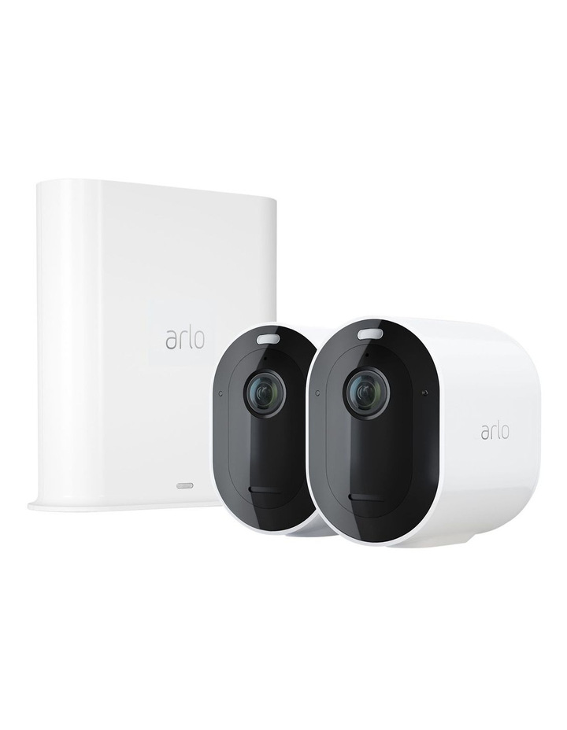
Arlo Ultra(Home Security Cameras)
4K UHD Video Resolution with HDR
Auto Zoom and Tracking
180-Degree Viewing Angle
Rechargeable battery
Easy Installation
Suitable for both indoors or outdoors

Slide 12
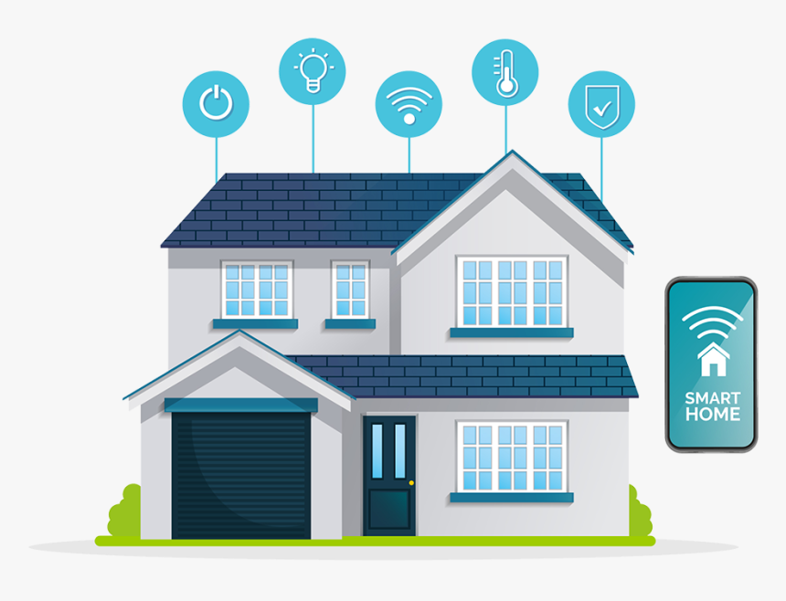
Conclusion
Smart Home Devices makes it possible for the house to take care of you

